Slide 1
Mobile Edition
January 2018
Based on Qt 5.10
N.N.
N.N@company.com

Slide 2
Contents
Getting Started | Android iOS WinRT Setup and Deployment
Qt in Mobile Platforms | Feature Parity Mobile User Experience Application Lifecycle
Mobile APIs | Sensors In-App Purchasing Positioning Location Connectivity
Native API Access | Android JNI iOS

Slide 3
Getting Started

Slide 4
Contents
Android
iOS
WinRT Setup and Deployment

Slide 5
Android – Setup
All phases from setup to app deployment to Google Play can be done in Qt Creator
Tools > Options > Devices : Android in QtCreator
Install JDK, and Android SDK and NDK
Setup the paths to the tools
Use SDK manager to install Android tooling
Enable USB debugging in the Android device, install USB driver into the host, if needed
https://developer.android.com/studio/debug/dev-options.html
Emulator works much faster with x86 ABI

Slide 6
Android – Deployment
Native Android project created for Android target
Any native files can be used
Java code, native assets (accessible as assets:// in Qt code)
APK creation
Projects mode – Build Android APK
Decide how Qt libraries deployed: Ministro service or app bundle
Deployment
Define Android-specific files with ANDROID_PACKAGE_SOURCE_DIR = $$PWD/android
Add app icons, versions, and permissions in the manifest file

Slide 7
iOS – Setup
Xcode and Xcode command line tools are enough
.xcodeproj created for iOS target
Check the target device is correct in Kit settings
Apple developer program requirements
Apple developer id
Device registration
Developer/distribution provisioning profile
Associates together device id, application bundle id, and developer certificate
Developer/distribution certificate

Slide 8
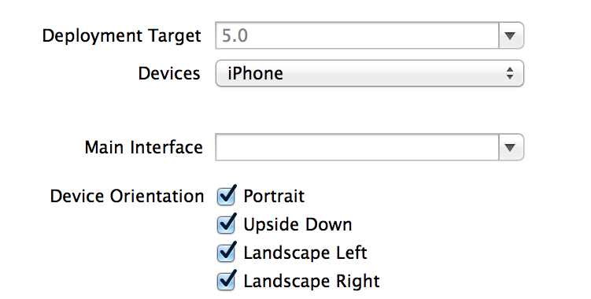
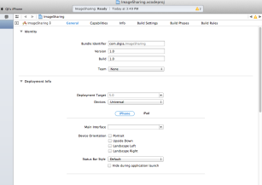
iOS – Deployment
Use .pro file variable QMAKE_BUNDLE_DATA to deploy assets
fontFiles.files = fonts/*.ttf
fontFiles.path = fonts
assets_catalogs.files =
$$files($$PWD/*.xcassets)
QMAKE_BUNDLE_DATA += assets_catalogs
Application icon must be deployed in the bundle and defined in the info.plist file using CFBundleIconFiles key
Xcode provides functionality to publish the app

Slide 9
WinRT – Setup & Deployment
Windows 10 with MSVC 2015 or newer needed
Development in Qt Creator or Visual Studio
No special project conversion needed
Create a VS project with qmake -tp vc <your project>.pro
Deployment
Use windowdeployqt tool, which will add Qt libraries and dependencies to the package
qmake -tp vc <your project>.pro "CONFIG+=windeployqt”
WinRT Runner can be used to install and test the package

Slide 10
Qt in Mobile Platforms

Slide 11
Qt in Mobile Platforms
Qt Company objectives in terms of mobility
Support Qt in major mobile platforms
Provide developers with cross-platform rather than native APIs
Minimize feature parity between platforms
Technology partners, such as V-Play (https://v-play.net) extend the mobile offering
Mobile games
Mobile apps
Additional mobile APIs
For example V-Play https://v-play.net

Slide 12
Feature Parity
Low between mobile platforms, but some features missing in some platforms
Lacking features in mobile platforms
UWP/WinRT | iOS | Android
Accessibility on WinRT | Classic BT | Multimedia widgets
BT LE Peripheral |  | Qt Quick dialogs
Print support on UWP
UWP style for widgets
Multimedia – video recording
Supported sensors are device/platform dependent

Slide 13
Mobile User Experience
Although Qt apps cab be built to mobile platforms, they seldom provide an optimal mobile UX without any changes
Make UI controls large enough
Create a layout and content for small screens
Design text input with the native virtual keyboard in mind
Should a user see the control behind the virtual keyboard, for example?
Design for multiple screen sizes and orientations
Design intuitive navigation
Save battery
Normally, you should not read sensors, when the application is in the background
Keep UI responsive

Slide 14
Application Lifecycle and Persistent Data
Qt applications behave like native mobile apps
Suspended application can be removed from the memory in case of out of memory
Applications are suspended, when the user switches to another app using a home or similar button
However, in iOS apps can collect data using Qt Positioning while in background
Native states are mapped to Qt::ApplicationStates enumeration

Slide 15
Application States
Qt::ApplicationActive – foreground top-most focused application
Qt::ApplicationInactive – application is visible, but not in the foreground
Pause or stop video playback, games, animations, and sensors – i.e. stop using CPU
Qt::ApplicationSuspended – application is about to suspend and not visible
User presses Home Screen button and navigates to another application
Save app state into a persistent storage, if needed (QSettings)
In this state, app may be removed from the memory at any time
Qt::ApplicationHidden – background application
Use, e.g. Android services for background services, which must run, even though the application exists
A separate process, logging GPS location, detecting NFC tags, waiting for social media notifications

Slide 16
Variations
Qt provides enums to implement platform or orientation-based variations
More detailed information, like major and minor version numbers is provided by QOperatingSystemInformation
Easy to check, if the OS matches with any of the given types - isAnyOfType(std::initializer:list<OSType>)
orientation: (Qt.platform.os === “android" ||
Qt.platform.os === "ios") ? -90 : 0

Slide 17
Mobile APIs

Slide 18
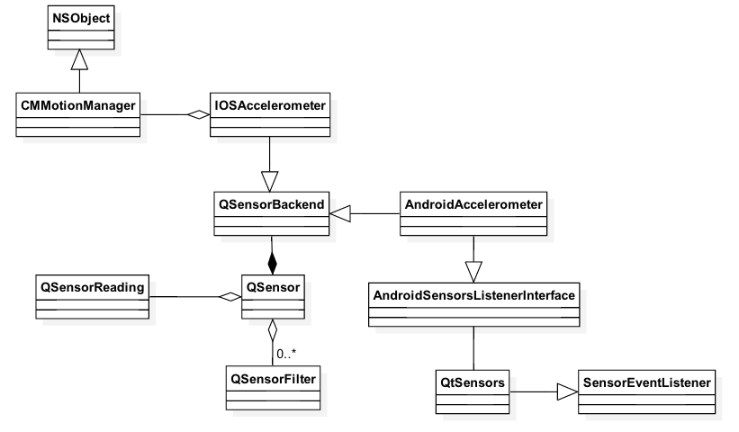
Mobile APIs – Architectures
Backend with platform-dependent code
Sensors, positioning, location
Similarities to P-IMPL
Pre-processor directives and platform-dependent source code
Bluetooth
NFC
In-app purchasing
Calling non-existent functionality just does not do anything
Both C++ and QML APIs available

Slide 19
Mobile API Usage – Sensors
// start the sensor
QSensor sensor("QAccelerometer"); sensor.start();
// later
QSensorReading *reading = sensor.reading();
qreal x = reading->property("x").value<qreal>();
qreal y = reading->value(1).value<qreal>();
import QtSensors 5.0
Text {
TiltSensor {
id: tilt; active: false
}
onSomeSignal: {
tilt.active = (tiltStart.text === "Start");
text: "X Rotation: " + tilt.xRotation
text: "Y Rotation: " + tilt.yRotation
text: "Proximity: " + (proxi.active ? (proxi.reading.near ? "Near" : "Far") : "Unknown")

Slide 20
Mobile API Usage – In-App Purchasing
Supports Android Google Play and iOS App Store
Makes it easy to monetize your application (new features, new items etc.)
Makes it easier to use the credit card information on your platform
Publish your application (possible using alpha or beta testing) and add new product in Google Play
Product Id
Product Type – Only Managed products supported by Qt
Price information
Activate the product
For iOS, use iTunes Connect to register your application and products
Qt supports only Consumable and Non-Consumable types
Add the name, description, screen shot, and pricing information of your product
Both C++ and QML types available

Slide 21
Mobile API Usage – In-App Purchasing
Register your products
Store {
Product {
id: myCoolProduct
identifier: "consumableProduct"
type: Product.Consumable
// Product.Unlockable
Implement UI elements to purchase products
Native functionality will handle the purchasing process (ask passwords, if needed etc.)
MouseArea {
enabled: !myCoolProduct.purchasing &&
myCoolProduct.status ===
Product.Registered
onClicked: {
myCoolProduct.purchasing = true;
myCoolProduct.purchase();

Slide 22
Qt Positioning
In QML, the Position element provides the user device’s current position
Coordinate, speed, time stamp
Using the PositionSource element,
The source (backend) may be specified (satellite/non-satellite, socket)
Update interval may be set
Supported and preferred positioning methods may be read
Position type property position may be read
import QtPositioning 5.2
PositionSource {
id: src
updateInterval: 1000
active: true
onPositionChanged: {
var coord = src.position.coordinate;
console.log("Coordinate:", coord.longitude, coord.latitude);

Slide 23
Qt Positioning – Location and Address
Location
Coordinate
Address
Bounding box
Typical use case:
Location query with GeocodeModel
GeocodeModel {
id: model
plugin: mapPlugin
}
onSomeSignalHandler: {
model.query(“Koskikatu …, Tampere, Finland”); // Address, string, coordinate
model.update();

Slide 24
Location Backend Abstraction – Plugin
Nokia (“here”), Open Street Maps (“osm”), Esri (“esri”), MapBox (“mapbox”, “mapboxgl“), and Items overlay (“itemsoverlay”) supported
Mapboxgl uses native mapping engine
Itemsoverlay provides an empty map, where map items can be used without occluding what's behind
Each plugin has plugin-specific configuration parameters - PluginParameter
Possible to set required features, what the plugin must support
Plugin {
id: mapPlugin
name: "osm"
// preferred: [ "osm", "here" ]
required: Plugin.RoutingFeature
PluginParameter { name: "name"; value: "value" } }

Slide 25
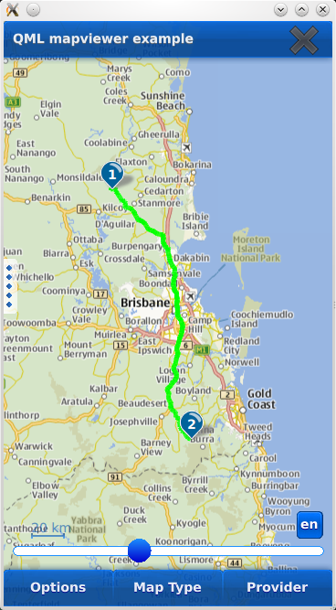
Location – Map
Displays the map
Supports touch gestures for rotating and tilting
Can show annotations (from the model) MapRectangle, MapQuickItem, MapItemView, MapItemGroup
Can show routes MapRoute
Map type (style: satellite, street, terrain; mobile, night)
Map {
id: map
plugin: mapPlugin
center {
latitude: positionSrc.position.coordinate.latitude
longitude: positionSrc.position.coordinate.longitude
}
zoomLevel: 8.0 // >= 0

Slide 26
Location – Places & Routes
Use the corresponding model to query for places or routes
PlaceSearchModel { searchTerm: “gasoline”; searchArea: currentCoordinate }
RouteModel { query: myQuery } // queryObject.addWaypoint(coordinate)
Use any view to show the model content as usual
For route data, there is already a delegate type MapRoute
Map {
RouteQuery { id: routeQuery }
RouteModel { id: routeModel; plugin: mapPlugin; query: routeQuery }
MapItemView { model: routeModel; delegate: routeDelegate }
Component { id: routeDelegate
MapRoute {
route: routeData
line.color: "blue"
line.width: 5
opacity: 0.8

Slide 27
Connectivity
NFC
NFC tag detection
Reading and writing NDEF messages, NDEF message handler registration
File and message sharing
Bluetooth
Local device information
Device and service discoveries
OBEX object push profile (not on Android)
Serial port profile via RFCOMM

Slide 28
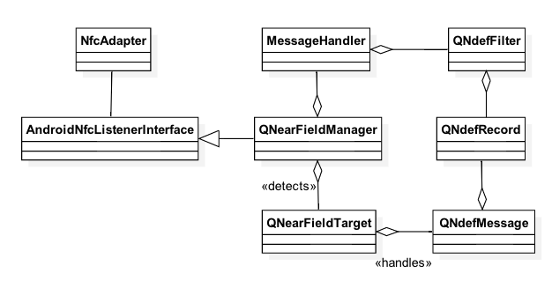
NFC
// Detecting NFC tags
m_manager = new QNearFieldManager(this);
connect(m_manager, SIGNAL(targetDetected(QNearFieldTarget*)), this,
SLOT(targetDetected(QNearFieldTarget*)));
connect(m_manager, SIGNAL(targetLost(QNearFieldTarget*)), this,
SLOT(targetLost(QNearFieldTarget*)));
m_manager->startTargetDetection();

Slide 29
Bluetooth
QBluetoothService DiscoveryAgent
QBluetoothSocket
QBluetoothServer
QBluetoothSocket
3. serviceDiscovered()
1. listen()
2. Register service
4. connectToService()
8. signal connected()
5. signal newConnection()
9. write()
10. signal bytesWritten()
6. nextPendingConnection()
7. signal readyRead()
Client
Server

Slide 30
QBluetoothServiceInfo
Bluetooth service attributes
Protocol, port, description, name, provider, service class Uuid
Defined as name and sequence pairs
Set with convenience functions
serviceInfo.setServiceUuid(QBluetoothUuid(serviceUuid));
Or with generic setAttribute() function
QBluetoothServiceInfo::Sequence publicBrowse;
publicBrowse << QVariant::fromValue(QBluetoothUuid(QBluetoothUuid::PublicBrowseGroup));
serviceInfo.setAttribute(QBluetoothServiceInfo::BrowseGroupList, publicBrowse);

Slide 31
Bluetooth
rfcommServer = new QBluetoothServer(QBluetoothServiceInfo::RfcommProtocol, this);
connect(rfcommServer, SIGNAL(newConnection()), this, SLOT(clientConnected()));
bool result = rfcommServer->listen(localAdapter);
// Set service attributes
serviceInfo.registerService(localAdapter);
socket = new QBluetoothSocket(QBluetoothServiceInfo::RfcommProtocol);
socket->connectToService(remoteService);
connect(socket, SIGNAL(readyRead()), this, SLOT(readSocket()));
connect(socket, SIGNAL(connected()), this, SLOT(connected()));
connect(socket, SIGNAL(disconnected()), this, SIGNAL(disconnected()));

Slide 32
Bluetooth QML Client
Device and service discovery
BluetoothDiscoveryModel
Set the mode (full, minimal, device) and UUID to limit services
Connect to deviceDiscovered() or serviceDiscovered() signals
Bluetooth service information
BluetoothService
Returned by the service discovery
Device address and name, service name, protocol, and description
Service UUID
Device and service connection and communication
BluetoothSocket
Set the service
Check the state (unconnected, connecting, connected, listening, closing)
Read and write data (property stringData)

Slide 33
Bluetooth QML Client
BluetoothDiscoveryModel {
id: btModel
running: true
discoveryMode: BluetoothDiscoveryModel.MinimalServiceDiscovery
onServiceDiscovered: {
socket.setService(service)
}
uuidFilter: "e8e10f95-1a70-4b27-9ccf-02010264e9c8"
}
BluetoothSocket {
id: socket
connected: true onSocketStateChanged: {
console.log("Connected to server")
}
onStringDataChanged: {
console.log("Received data: “, socket.stringData);
}
}

Slide 34
Native API Access

Slide 35
Native Android Apps – Application Components
Activity | One UI in the application Typically full screen Compare to a page / view
Broadcast Receiver | Response to an event or a notification Can launch an application Incoming phone call, network connection established
Service | Background task without the UI Keeps running while user navigates to another application Music Player, Location Tracker
Content Provider | Shares content between apps (processes) Contacts
APK #1/Process
APK #2/Process

Slide 36

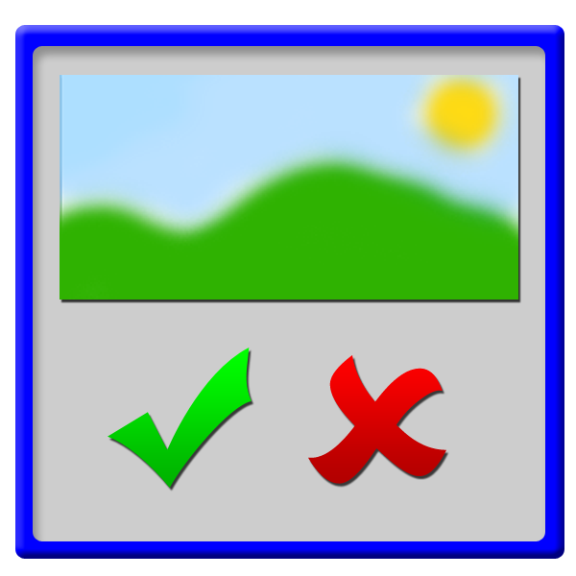
Android Activity
onCreate()
onStart()
onResume()
onPause()
onStop()
onDestroy()
onTouchEvent()
onUserInteraction()
etc.
Looper
<<main thread>>
Activity

Slide 37
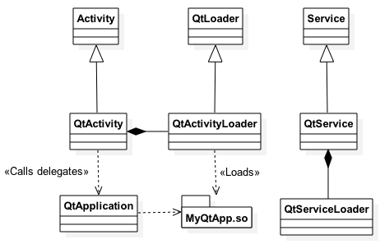
Qt Android Apps
Native process with a GUI thread, running a Dalvik VM
Launces an activity
Activity uses the loader to load Qt libs using Ministro or bundle
Creates QtApplication , which works as a delegate for event handling
Events handled natively in the activity => propagated to QPA plugin using the application delegate
In C++, main integration takes place in androidjnimain.cpp (part of the Andoird QPA plug-in)
Creates a new thread and starts handling Qt events in the thread
Uses JNI to access Android native functions (application state, screen orientation, create Drawables, show status bar etc.)

Slide 38
Native APIs Android
Provided by Qt Android Extras module
QAndoirdJniEnvironment – attaches your thread to Dalvik VM
QAndroidActivityResultReceiver – implement to get notifications about QtActivity start activity functions
QAndroidJniObject – provides APIs to call Java methods
Call static and non-static methods, set and get object fields
You need to provide a signature of a method “(Arguments)ReturnType”
All object types are returned as QAndroidJniObject

Slide 39
Arguments and Return Types in Signatures
jboolean | Z |  | void | V
jbyte | B |  | custom | L<fully qualified name>
jchar | C |  | jobject | Ljava/lang/Object;
jshort | S |  | jclass | Ljava/lang/Class;
jint | I |  | jstring | Ljava/lang/String;
jlong | J |  | jthrowable | Ljava/lang/Throwable;
jfloat | F |  | jobjectArray | [Ljava/lang/Object;
jdouble | D |  | jarray | [<type>

Slide 40
Java Class
package io.qt.training;
// Create a source folder by using the fully qualified class name
class Dummy {
public static int simpleMethod(String string) {
String anotherString = new String(“Hello”);
if (string.startsWith(anotherString))
return checkUsingNativeCode(string);
else
return 0;
}
private static native int checkUsingNativeCode(String string);
}

Slide 41
JNI – Calling Java Methods from C++
QAndroidJniObject string = QAndroidJniObject::fromString("Hello World");
QAndroidJniObject example = QAndroidJniObject::callStaticObjectMethod(
”io/qt/training/Dummy", ”simpleMethod"
”(Ljava/lang/String;)I"
string.object<jstring>());

Slide 42
JNI – Calling C++ Methods from Java
static void callFromJava(JNIEnv *env, jobject thiz, jstring string)
{
QString aString(env->GetStringUTFChars(string, 0));
}
void registerNativeMethods()
{
JNINativeMethod methods[] {{"checkUsingNativeCode", "(Ljava/lang/String)I",
reinterpret_cast<void *>(callFromJava)}}; QAndroidJniObject javaClass("io/qt/training/Dummy");
QAndroidJniEnvironment env;
jclass objectClass = env->GetObjectClass(javaClass.object<jobject>());
env->RegisterNatives(objectClass, methods, sizeof(methods) / sizeof(methods[0]));
env->DeleteLocalRef(objectClass);
}

Slide 43
Custom Activity
Subclass QtActivity Java class or implement new classes
Implement Java functions to
Create new activities
Read data from content providers (calendar, camera, phone book)
Send intents for broadcast receivers (or receive broadcast message yourself)
Start services (possibly running in the background)
Implement corresponding C++ functions and expose to QML, if needed
Use Qt Android Extras module classes to implement the glue between C++ and Java

Slide 44

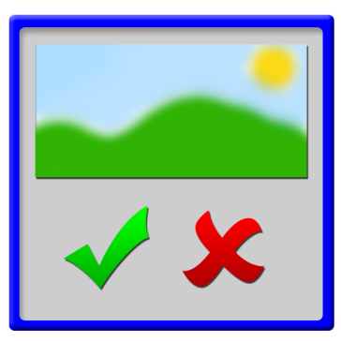

Intents
Message to communicate with other UI components possibly in other threads or processes
Intent Filter
Activity
Context.startActivity() or
Activity.startActivityForResult()
getIntent()
Activity.setResult()
onAcitivityResult()

Slide 45
Qt Android Extras
Convenience classes and functions for Android development
QtAndroid namespace
QAndroidJniObject QtAndroid::androidActivity();
QAndroidJniObject QtAndroid::androidContext();
QAndroidJniObject QtAndroid::androidService();
void QtAndroid::runOnAndroidThread(const Runnable &runnable);
Services
QAndroidService, QAndroidServiceConnection
Object communication
QAndroidBinder, QAndroidParcel, QAndroidIntent

Slide 46
iOS

Slide 47
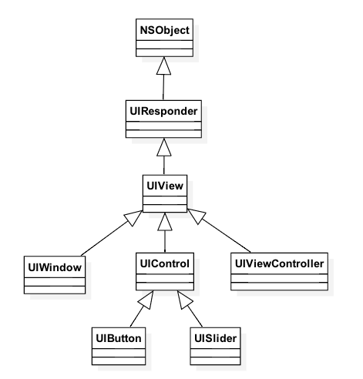
Native Apps iOS
MVC pattern
Controller
Manages the view
Works as a delegate for changes in the model
Provides an interface to access iOS frameworks (libraries)
Address book, event kit, message UI, telephony etc.
Application framework handles the navigation between views using controllers
View is a rectangle area on a window
Similar to QWidget inside QWindow

Slide 48
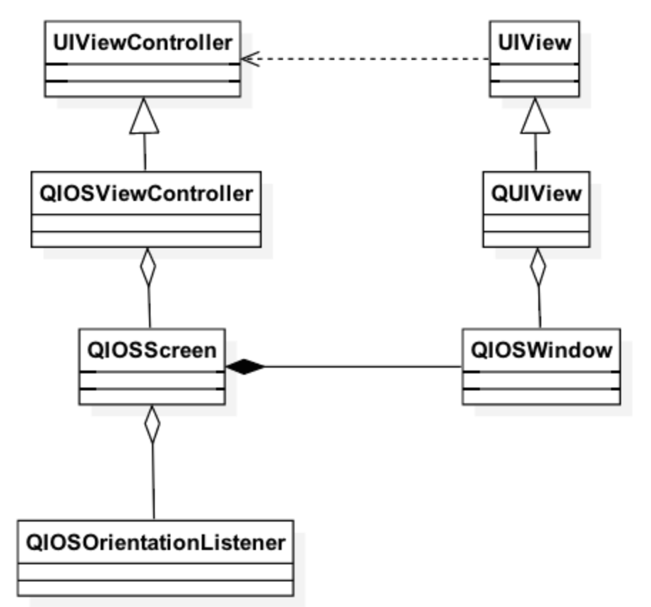
Qt iOS Apps
Based on Cocoa’s Model-View Controller Framework, provided by UiKit framework
UIController manages the memory and navigation between windows (views) – does not exist in Qt
UI view corresponds to Qt window
UI controls are sub-windows / views
QWindow mapped to UIViewController
Allows navigation to address book, calendar, messaging

Slide 49
Native APIs iOS
Possible to mix C++ and Objective-C
Use .mm suffix for your source code files
Add sources into OBJECTIVE_SOURCES variable in the .pro file
You may use QMAKE_INFO_PLIST variable to refer to your info.plist file
Get the native UiView from the .qpa plugin
UIView *view = static_cast<UIView *> (QGuiApplication::platformNativeInterface() -> nativeResourceForWindow("uiview", window()));

Slide 50
Native APIs iOS
Use UiView to get the UiViewController
UIViewController *qtCtrl = [[view window] rootViewController];
Set the delegate
Handles the callback after data have been picked or chosen
Create a new controller
Picker – pick an image
Chooser – choose a file
Navigate to a new view using the controller

Slide 51
Thank You
training@qt.io

